Slide 1
CS Presentation
By: Azeez, Biyi, Sekou

Slide 2
Challenges you faced
Meeting - We all had very different schedules, and so meeting was very difficult because in order to come together as a group we had to look find good times for each other.
Managing the system design document - There was lots of content in there, and sometimes data within the system design document would be disorganized, or would be outdated.
Aiming the robot - Aiming the robot was a great challenge because in order to improve our block code, we had to make sure to consistently aim the robot extremely precisely, so that any flawed movement by the robot was because of bad code and not sloppy aiming.

Slide 3
Group Roles
Sekou - lead data manager / data recorder - Sekuo managed the bulk of the system design document, and recorded down all our groups ideas for different stuff like the requirements table, or the project dependencies, etc. Basically managed the system design document. Also recorded the data of our testing results.
Biyi - assistant data tester / data recorder / robot recorder - Biyi did general work. His role was conditional and did whichever work was most demanding at the time. He assisted azeez with testing, and coming up block code fixes, and also helped out sekou with some areas in the system design document, and making sure there were writing errors.
Azeez - lead programmer / tester / manager - Azeez programmed all the block code, and lead the robot testing, constantly adjusting the code according to test results.

Slide 4
What we’ve learned
Time Management – We all had very busy schedules, so we had to manage what time we had together efficiently. We also had deadlines to meet, so we had to make sure to get all our work in before those deadlines. Also our robot always died quickly, so when we worked we had to work under the assumption that our robot wouldn’t last long. Overall under time constraints, we learned to work faster.
Problem Solving - We learned problem solving because while trying to get robot to go over the course, we had to constantly deal with problems depending on time sprint. For each of these problems, we had to solve them by identifying the problem, then coming up with solutions. We learned to adapt a trial and error approach throughout the project.
Teamwork – This was a really big project so we had to learn to work together in order to get all the work done. We gradually learned to coordinate with each other better, and everyone fell into the roles they had to play well. We also learned to communicate with each other our ideas more smoothly over time.

Slide 5
Things to differently for next time
We should be more careful to check the rubric before submitting the final assignment, because on the first sprint, our group some of the required documents in the github repository we submitted.
Make sure to keep sphero completely charged a couple hours before testing - lots of the times we came in with the plan to complete the robot video, we ended up being slowed down because our robot would die before fully completing out block code
We should make sure to record more videos, because lots of times we while just testing for results we actually could’ve gotten a good video, but didn’t because we didn’t expect it to actually go over the entire course.

Slide 6
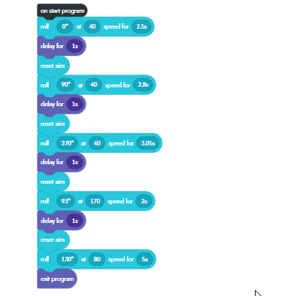
Block Code
We had the robot roll at a slow speed, and added a
delay so it would accurately roll around the
obstacles without skidding off target,
then we had it change to a higher speed so it had enough
momentum to go over the ramp. Then switched it
back to a moderate speed and aimed it at the pins.

Slide 7
